Slide 1

“Uncovering Hidden Value, Unlocking Potential”
Group 11: Leonard Taraku
Jainish Rathod
Parva Shah
Ridsa Tangkuman
Herman Brurberg
Notes:
Hello dear investors.
We are NOW Corp, and we are here to ask for funding of 3 billion dolllars by uncovering hidden value, and unlocking huge potential.

Slide 2
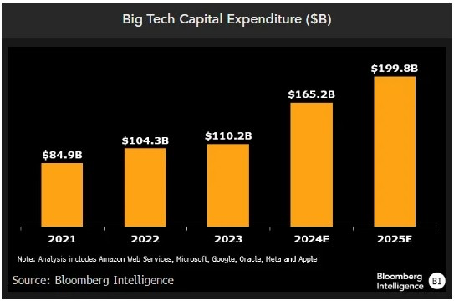
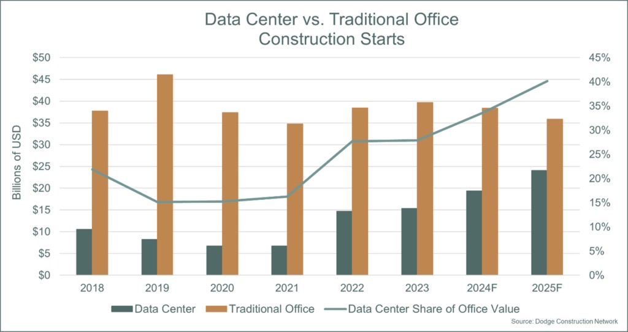
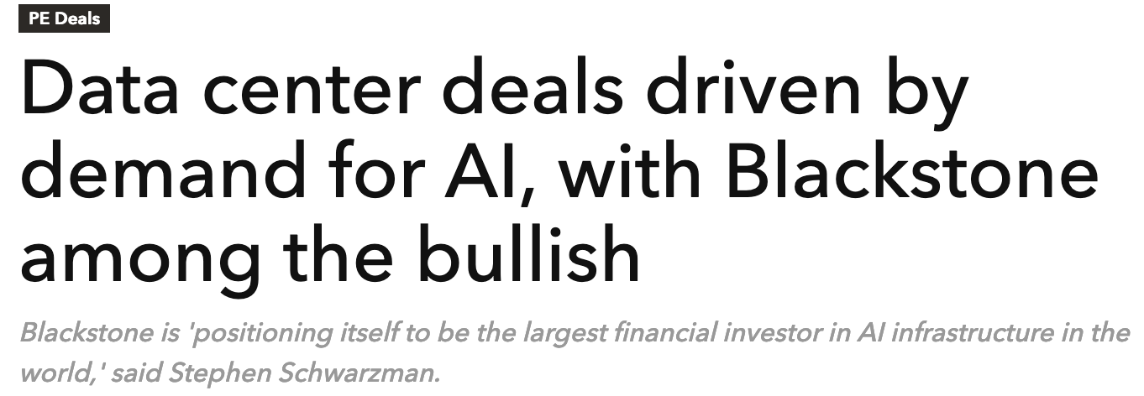
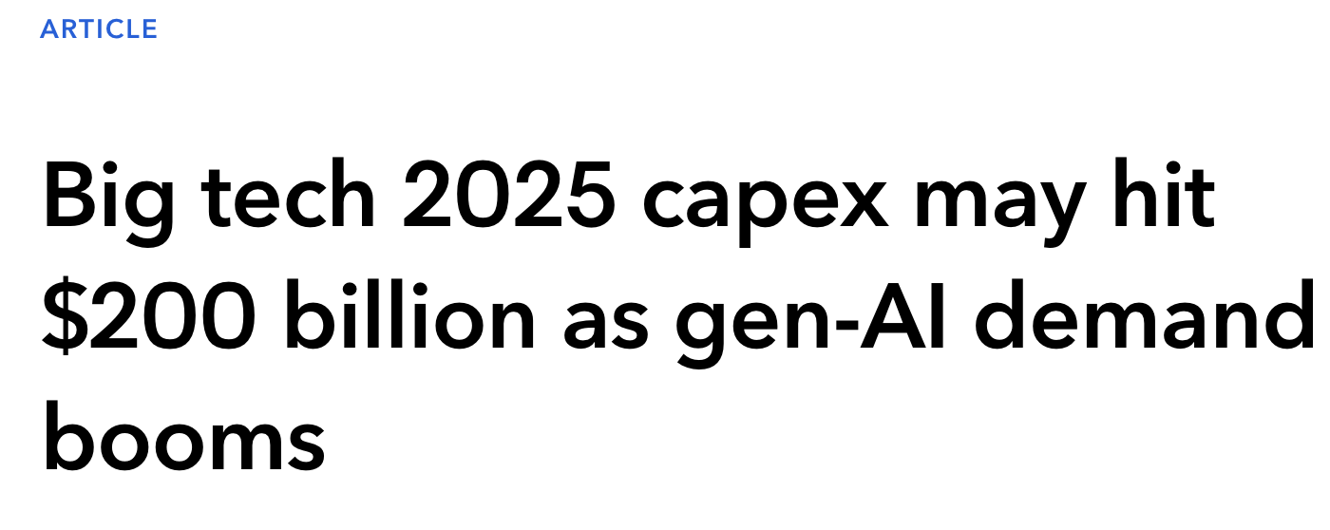
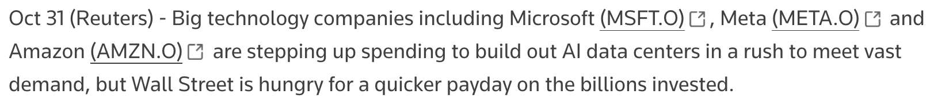
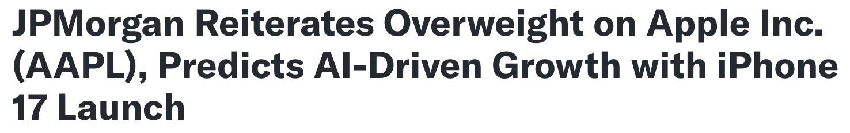
Investment theme
Growth in semiconductors driven by AI and cloud computing expansion.
Notes:
$1.3 trillion dollar market by 2032. Yes you heard right. That will be the market of Artificial intellegence by 2032. Companies are racing to dominate this space, investing billions in infrastructure to power next-generation applications. Our investment thesis focuses on the NOW theme: semiconductors, the backbone of this transformation.
Theme:
"Our thesis is built on the rapid growth in data centers and generative AI, fueled by massive capex increases from tech giants like Amazon, Microsoft, and Google. Semiconductors, particularly from companies like TSMC, ASML, and ARM, are the critical drivers of this revolution.

Slide 3
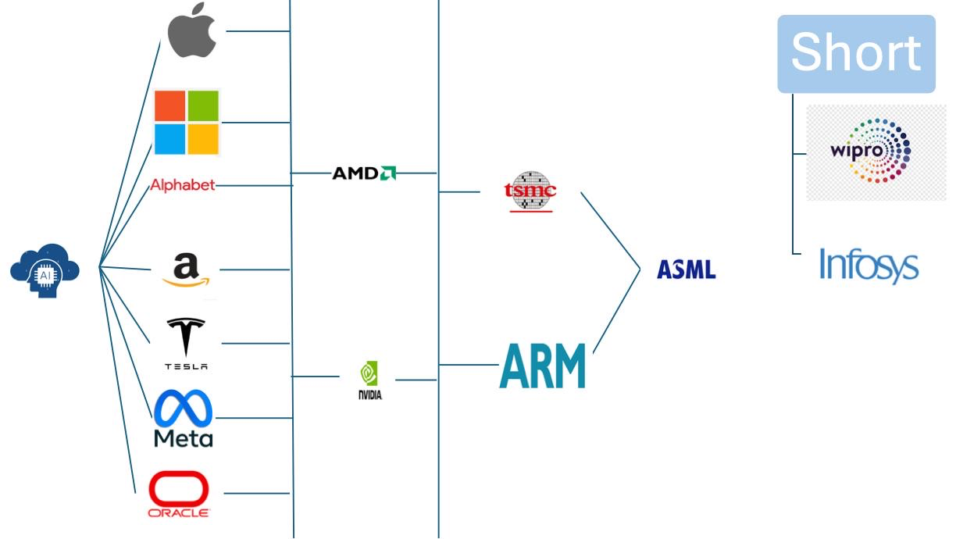
Industry Analysis – Domino
Notes:
This chart demonstrates the domino effect driving the semiconductor industry. At the top, we see tech giants like Apple, Microsoft, Amazon, and Tesla, all heavily investing in AI and cloud infrastructure. Their demand fuels growth in GPU leaders like NVIDIA and AMD, who rely on foundries like TSMC and innovators like ARM for cutting-edge chips.
At the foundation of this chain is ASML, the exclusive supplier of EUV technology, enabling next-gen manufacturing. These companies are the backbone of the AI and cloud revolution.
In contrast, companies like Wipro and Infosys are on the losing end of this evolution. With AI replacing traditional outsourcing services, these businesses face significant headwinds, making them strong short candidates.
This ecosystem highlights why we’re focusing on semiconductors for long positions while strategically shorting vulnerable players.

Slide 4

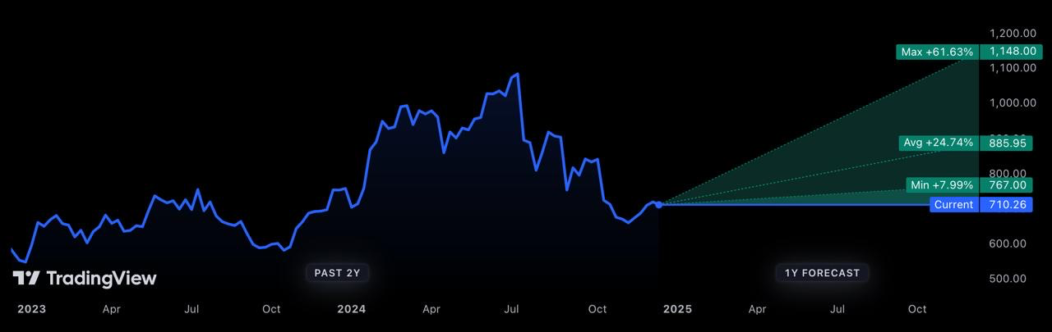
Investment thesis - ASML
Leading supplier to the semiconductor industry
Monopoly on EUV technology
Hardware, Software, Service for microchip production
Rising industry demand
Big patent portfolio
Consistent revenue growth
Partnerships with biggest companies in the world
Powerholder
Undervalued: Stock price $710.26 --> $1,675
TradingView. (n.d.). Retrieved December 19, 2024, from tradingview.com
Stock price: $710.26 --> $1148
4 YEARS: $1675
Notes:
ASML is the leading supplier to the semiconductor industry, holding a monopoly on EUV technology, essential for producing advanced chips. Its portfolio spans hardware, software, and services, making it indispensable in the microchip production ecosystem.
Rising industry demand and ASML's large patent portfolio secure its position as a technological powerhouse. Partnerships with the world’s biggest tech companies, such as TSMC and Intel, further reinforce its dominance.
Despite consistent revenue growth, ASML remains undervalued, with the current stock price of $725 projected to reach $1,148, offering a 61% upside. As a critical enabler of next-gen semiconductor technology, ASML is a must-have investment for the AI-driven future.

Slide 5

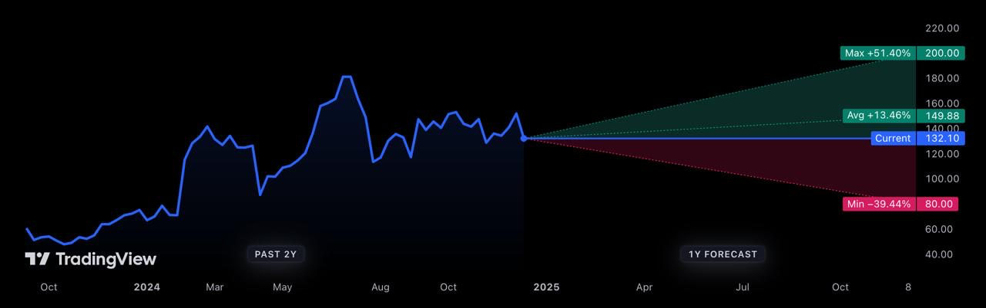
Investment thesis – ARM
Global leader in CPUs
Market dominance (99%)
Energy-efficient CPU
Partnerships with largest companies in the world.
Powerholder
EBITA margin: 25%
Undervalued: Stock price $132.10 --> $257
TradingView. (n.d.). Retrieved December 19, 2024, from tradingview.com
Stock price: $132.10 --> $200
4 YEARS: $257
Notes:
ARM is the global leader in CPU design, powering 99% of the world’s smartphones and dominating the semiconductor market with its energy-efficient architecture. Its technology is critical for AI and IoT, aligning perfectly with the growth in cloud computing and advanced devices.
With key partnerships across tech giants like NVIDIA, Amazon, and Qualcomm, ARM has diversified and stable revenue streams. Despite a strong EBITA margin of 25%, the company remains undervalued, presenting significant upside potential with forecasts suggesting a 51.4% gain.
ARM is uniquely positioned at the intersection of AI, IoT, and mobile computing, making it an essential investment for capitalizing on the future of semiconductors.

Slide 6
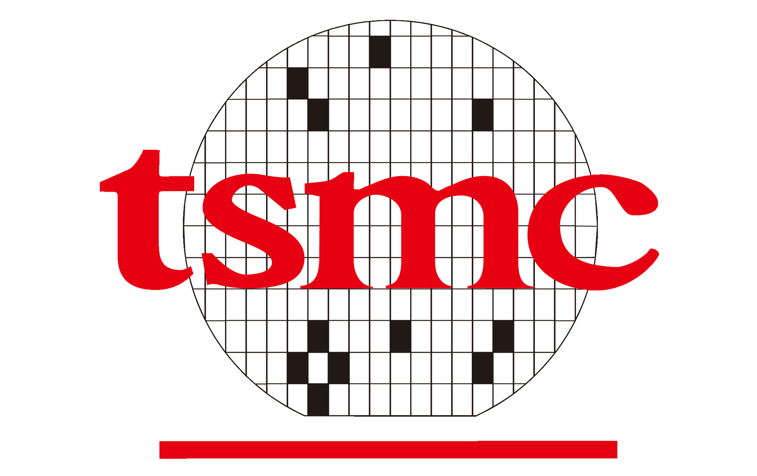
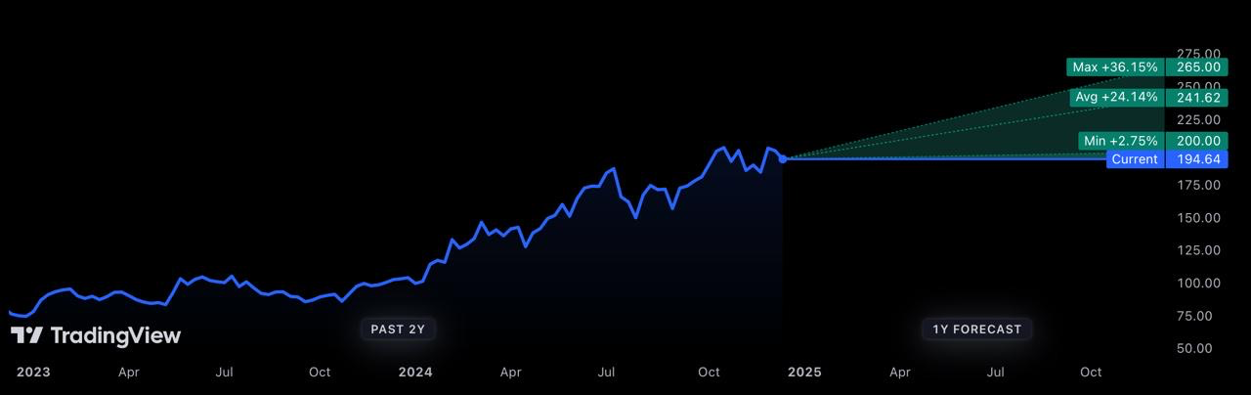
Investment thesis - TSMC
Worlds largest semiconductor foundry
Known for leading-edge nodes such as 3nm and 5nm chips
2025 expansion to US and Japan
Holds more than 60% global foundry market
Partnerships with largest company in the world
Powerholder
Undervalued: Stock price $194.64 --> $460
TradingView. (n.d.). Retrieved December 19, 2024, from tradingview.com
Stock price: $194.64 --> $265
4 YEARS: $460
Notes:
TSMC is the world’s largest semiconductor foundry, commanding over 60% of the global market. Known for its leading-edge nodes like 3nm and 5nm chips, TSMC is indispensable for high-performance computing, AI, and advanced devices.
The company is actively expanding its footprint with new fabs in the US and Japan by 2025, diversifying geopolitical risks while meeting surging global demand. TSMC’s strategic partnerships with top tech giants, including Apple and NVIDIA, solidify its position as a key supplier in the semiconductor ecosystem.
Despite its dominance and strong growth potential, TSMC remains undervalued, with forecasts indicating up to a 36% upside. As a powerholder in the industry, TSMC is a critical investment to capture the exponential growth in AI and advanced computing.

Slide 7


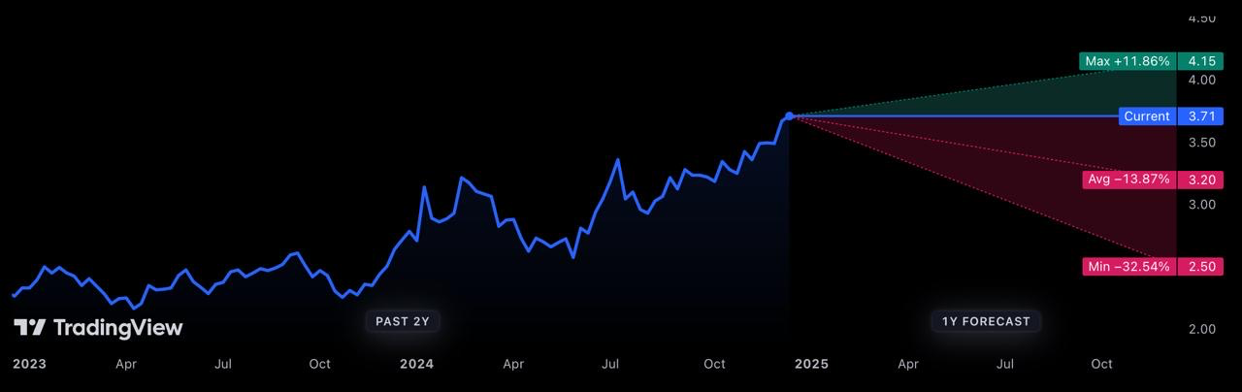
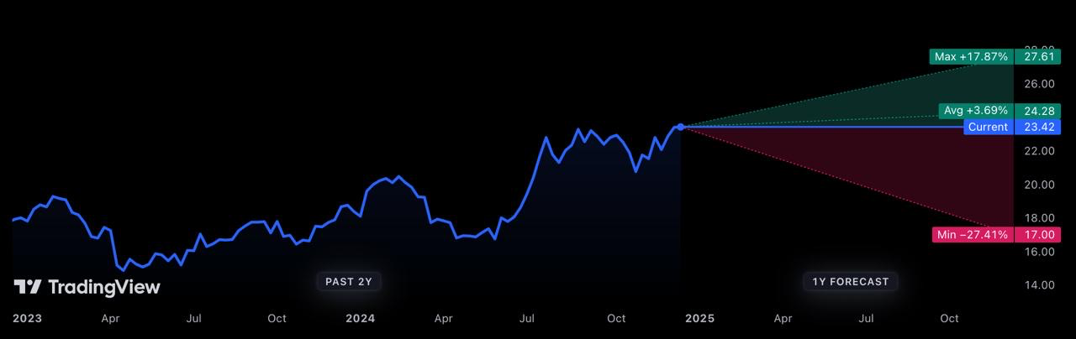
Investment Thesis – SHORT CALL
BPO/IT Services Pressure from AI: Both companies face significant challenges in the BPO sector, where AI-driven automation is increasingly replacing labor-intensive outsourcing solutions.
AI Replacing BPO/IT Services: AI-driven automation threatens BPO/IT revenue streams for both companies.
Revenue Decline: Wipro: Reported $2.66 billion in revenue, down by 1.0% YoY, missing analyst consensus ($2.67 billion). Infosys: Reported $4.58 billion in revenue, missing analyst estimates ($4.63 billion), driven by a slowdown in traditional BPO services.
Stock price: $3.71 --> $2.50
Stock price: $23.42 --> $17.0
Notes:
Wipro and Infosys face significant headwinds due to the rise of AI-driven automation, which is replacing traditional BPO and IT services. Wipro's revenue fell by 1.0% YoY to $2.66 billion, missing analyst estimates, while Infosys reported $4.58 billion, also below expectations.
· The BPO/IT services sector, once reliant on labor-intensive outsourcing, is under immense pressure from AI advancements, threatening core revenue streams for both companies.
· With Wipro’s stock projected to drop from $3.71 to $2.50 and Infosys from $23.42 to $17.00, we see clear downside potential. The structural challenges posed by automation make these companies strong candidates for a short position.

Slide 8
Investment horizon
$3 Billion investment
Company | Holding Periods | Portfolio Allocation | Entry Price | Exist Price | Stop Loss | Max return | Max loss
ASML Holding N.V. | 4 Years | $1,080,000,000 | $715 | $1,675 | $675 | 134.2% | -5.5%
Arm Holdings | 2 Years | $810,000,000 | $135 | $257 | $110 | 90.3% | -18.5%
Taiwan Semiconductor Manufacturing Company Limited | 4 Years | $810,000,000 | $200 | $460 | $150 | 125.0% | -10.0%
Short |  | Portfolio Allocation | Entry Price | Exist Price | Stop Loss | Max Return | Max Loss
WIPRO | 1 Year | $150,000,000 | 3.70 | 2.5 | $5 | 48.00% | -26.00%
INFOSYS | 1 Year | $150,000,000 | 23.0 | 17.0 | $30 | 35.29% | -23.33%
Notes:
Our investment strategy combines long-term growth opportunities with short-term defensive plays.
For the long positions, we allocate:
$400 million to ASML for a 4-year horizon, with an expected return of 58.3%, leveraging its EUV technology monopoly.
$300 million to ARM for 2 years, capitalizing on its energy-efficient CPU dominance and a projected return of 42.9%.
$300 million to TSMC for 4 years, banking on its leadership in advanced chip nodes and a 30% return.
For the short positions, we allocate:
$100 million each to Wipro and Infosys, targeting their revenue declines due to AI disruptions, with potential returns of 48% and 35.29%, respectively, over a 1-year horizon.
This balanced portfolio approach ensures we capitalize on semiconductor growth while mitigating risk through targeted shorts.

Slide 9
Risk & Monitoring
Risk
The United States-China Chip wars tensions.
WIPRO and INFOSYS: Shift Toward Digital Services.
China invade Taiwan
Monitoring
Weekly assessing the market movements and adjusting it according to stop losses/max returns.
Understand the macros around data centers and AI based on Trump policy.
Observe the competitors' movements of the companies.
Notes:
While our investment strategy is robust, we remain vigilant about the following risks:
US-China chip war tensions, which could disrupt supply chains and affect TSMC and ASML.
Wipro and Infosys shifting toward digital services, potentially mitigating the short thesis.
A potential Chinese invasion of Taiwan, a geopolitical risk that could significantly impact TSMC.
To manage these risks, we have a monitoring framework:
Weekly market assessments to ensure stop losses are adjusted proactively.
Tracking macroeconomic policies around data centers and AI, particularly shifts in US policy.
Closely observing competitor movements to anticipate and react to strategic shifts in the industry.
This approach ensures we adapt quickly and protect our investment from foreseeable challenges.

Slide 10
Conclusion
Heavy capital expenditure in AI and cloud technologies by Big 7
2. Demand by NVIDIA & AMD
3. Supplied by: ASML, ARM, and TSMC --> Powerholders
4. Undervalued: ASML, ARM, and TSMC, are undervalued due to market first round AI short-term focus. Demand is increasing due to long term focus.
5. Short Wipro and Infosys face significant downside risk in the short term due to the decline of traditional BPO revenue caused by AI and automation.
Notes:
Our conclusion highlights five key takeaways:
Heavy capital expenditure by the Big 7 tech companies is accelerating AI and cloud technologies, driving market expansion.
Demand by NVIDIA and AMD underscores the growing need for advanced semiconductors in AI and high-performance computing.
Supplied by ASML, ARM, and TSMC—these companies are the powerholders, enabling cutting-edge semiconductor innovation.
Undervalued opportunities: ASML, ARM, and TSMC remain undervalued despite their central role in AI and cloud, presenting significant upside potential.
Short Wipro and Infosys—these companies face immediate downside risk as AI disrupts traditional BPO revenue streams.
This strategy ensures we capture long-term growth while leveraging short-term opportunities.

Slide 11
Reference:
Yahoo Finance. (2024). Arm, Qualcomm contract fight threatens $1.4 billion design market. Retrieved from https://finance.yahoo.com/news/arm-qualcomm-contract-fight-threatens-185118506.html
TradingView. (2024). Arm CEO downplays ambitions to make its own chip in Qualcomm case. Retrieved from https://www.tradingview.com/news/reuters.com,2024:newsml_L6N3NH0HX:0-arm-ceo-downplays-ambitions-to-make-its-own-chip-in-qualcomm-case/
TradingView. (2024). Arm vs. Qualcomm: The $1.4B chip design battle that could reshape tech. Retrieved from https://www.tradingview.com/news/gurufocus:48f9cc39e094b:0-arm-vs-qualcomm-the-1-4b-chip-design-battle-that-could-reshape-tech/
Yahoo Finance. (2024). Better chip stock: ASML vs. AMD. Retrieved from https://finance.yahoo.com/news/better-chip-stock-asml-vs-092500677.html
PE Hub. (2024). AI drove demand for data center deals, with Blackstone among the bullish. Retrieved from https://www.pehub.com/ai-drove-demand-for-data-center-deals-with-blackstone-among-the-bullish/
Bloomberg Professional. (2024). Big tech 2025 CAPEX may hit $200 billion as Gen AI demand booms. Retrieved from https://www.bloomberg.com/professional/insights/technology/big-tech-2025-capex-may-hit-200-billion-as-gen-ai-demand-booms/
Reuters. (2024). Meta and Microsoft lift AI spending, worrying Wall Street ahead of Amazon results. Retrieved from https://www.reuters.com/technology/artificial-intelligence/meta-microsoft-lift-ai-spending-worrying-wall-street-ahead-amazon-results-2024-10-31/
ConstructConnect. (2024). Rising demand fuels surge in US data center construction. Retrieved from https://www.constructconnect.com/construction-economic-news/rising-demand-fuels-surge-in-us-data-center-construction/
TradingView. (2024). Firms including chip equipment maker ASML set up fund for Eindhoven development. Retrieved from https://www.tradingview.com/news/reuters.com,2024:newsml_L1N3NJ0NU:0-firms-including-chip-equipment-maker-asml-set-up-fund-for-eindhoven-development/
TradingView. (2024). Microsoft deal signals booming demand from data centers to power AI. Retrieved from https://www.tradingview.com/news/reuters.com,2024:newsml_L4N3NI0SX:0-microsoft-deal-signals-booming-demand-from-data-centers-to-power-ai/
Nasdaq. (2024). ASML institutional holdings. Retrieved from https://www.nasdaq.com/market-activity/stocks/asml/institutional-holdings
TradingView. (n.d.). ASML Holding N.V. (NASDAQ: ASML). Retrieved December 19, 2024, from https://www.tradingview.com/symbols/NASDAQ-ASML/
TradingView. (n.d.). Taiwan Semiconductor Manufacturing Company Limited (BCBA: TSMC). Retrieved December 19, 2024, from https://www.tradingview.com/symbols/BCBA-TSMC/
TradingView. (n.d.). Arm Holdings PLC (NASDAQ: ARM). Retrieved December 19, 2024, from https://www.tradingview.com/symbols/NASDAQ-ARM/
TradingView. (n.d.). Wipro Limited (NYSE: WIT). Retrieved December 19, 2024, from https://www.tradingview.com/symbols/NYSE-WIT/
TradingView. (n.d.). Infosys Limited (NYSE: INFY). Retrieved December 19, 2024, from https://www.tradingview.com/symbols/NYSE-INFY/
The Motley Fool. (2024, March 27). Will Arm Holdings be a trillion-dollar stock by 2030? Retrieved from https://www.fool.com/investing/2024/03/27/will-arm-holdings-be-trillion-dollar-stock-2030/#:~:text=Arm%20currently%20sports%20a%20forward,Fool%20has%20a%20disclosure%20policy
Nasdaq. (n.d.). Will TSMC be worth more than Apple by 2030? Retrieved from https://www.nasdaq.com/articles/will-tsmc-be-worth-more-apple-2030
CoinPriceForecast. (n.d.). ASML stock forecast 2023, 2024, 2025, 2030. Retrieved from https://coinpriceforecast.com/asml-stock#google_vignette

