Slide 1

Building Go To Market Strategy

Slide 2
Need Gap Analysis
1
Need/Problem
Lack of convenient external assistance to elderly population of India for their activities.
2
Want/Solution
An app which connects professional care takers(youth companions) & the elderly people or their families to avail various services.
3
Demand
Want + Willingness to pay ( professional care taking services for the elders + Starting with free trials/discounts on hourly services )
4
Desire
Want + Can't be replaced ( Professional care taking services for the elders + Quality of our services and Public trust)
5
Satisfaction
Expectations - No inconvenience caused and all tasks completed
Perceived Delivery- Highly trained youth companion +SOP’s +proper feedback mechanism
6
Loyalty
Customers will try our service given its unique positioning. Quality of our services & our care takers will build behavioral loyalty
Thus building the loyalty on availing the services again and again.

Slide 3



Market Scanning Analysis
Porter’s 5 Forces
AIDA
Threat of Substitute
Threat of new entry
Awareness
Corporate awareness program ( targeting working people )
Newspaper/Pamphlets ( targeting elderly people )
Desire
Using customers reviews & testimonials as a point to building the trust (making them strongly feel safe with care mate )
Action
Availing CareMate services for its highly trustable services.
Interest
Having free trials for elderly people living a
First time user discount
Moderate
(maids ,oldage home)
High
Extent of industry rivalry
Low
Bargaining power of buyers
Bargaining power of supplier
Low
Moderate
(Young and trained care takers)

Slide 4
SWOT
PESTLE
Strength
Opportunity
Political
Economical
Rising disposable income in tier 1 and tier 2 cities creates a potential customer base. Economic instability could affect affordability for some customers.
Social
Technological
Legal
Increase in nuclear families and working couples creates demand for eldercare solutions. Changing social attitudes towards professional eldercare services.
Government initiatives promoting senior citizen care can benefit the service.
Advent of generative AI can make our services more user friendly.
Labor laws and regulations governing employee rights need to be followed. Data privacy regulations must be adhered to when using technology platforms.
Environmental
Eco-friendly transportation options could be a differentiator.
Easy to use, Tech-enabled app
Extensive training for youth companion before deploying.
Young, Compassionate people driven brand
Scalability due to digital nature of the product
Partnerships with senior living facilities or hospitals.
Very high customer satisfaction rate which is unheard in this localized agency driven business.
Unique positioning allows us to stand out and get more eyeballs.
Collaborations with corporate employers for employee benefit packages
Weakness
Threat
Low control on the youth companion (service provider) after the training.
Hard to quantifiably track the quality of the service.
The services can be easily replicable
Youth companion and the customer might form a personal relation and connect directly.
Vulnerability of the brand reputation is very high due to mediocre service .
Emergence of new competitors
Social stigma: Possible resistance to letting outsiders assist the elders.

Slide 5
Segmentation
Primary Research
( information collected from the customers)
Clusters + Profiling
1. Corporate Leaders
Busy Lifestyle, can’t take care of elderly parents all the time Earns well and can afford a caregiver for all elderly needs Want their parents to have all the convenience they can provide
Eg) Ajay Mishra (works at an MNC, 40years old, vice president at his company
Secondary Research
( information from experts, historical data and discussion guide)
2. NRI/People living out of station:
Frequently traveling or living abroad for work or education, Unable to provide day-to-day care for elderly parents due to distance and commitments abroad, seeking comprehensive support services to ensure their parents' well-being and convenience in their absence.
Eg) Priya Patel(Software Engineer living in the USA, aged 35)
Qualitative
Quantitative
Who takes care of your parents when you go out on trips?
Do you face any challenges, taking care of your elders?
What qualities are you looking for in the youth companion (service provider)
Will you trust an external source to take care of elderly?
How much do you spend on your parents healthcare/General care ?
On a scale of 1 to 5, how challenging do you find caring for elderly family members?
How regularly do you take your parents out for errands and hospital runs?
3. Experienced warriors
Elderly people living alone or with their partner.
Have earned enough money but either do not have children or not very connected to them
Feel lonely due to restricted movement and social life
Want assistance in all facets of life
Eg) Jay Khemka (75 year old living with his 73 year old wife. Earned very well in his career, difficulty in passing time

Slide 6
Targeting
Positioning
Our Target segment is Experienced warriors
Point of Parity
Point of Difference
Sales Potential
High
Category
While most new age stratups in this field focus only on very specific problems, we are an one-stop solution for all elder needs.
In contrast to local agencies doing the same thing, we provide a seamless tech-experience as well ensure trust and reliability.
We are building the urbanclap for elderly needs.
Unique need
High
Eldercare Services Industry
Profit Potential
High
Competition
Good Fellow India
Portea, Local Agencies

Slide 7
4P’s of Marketing - Product
Core benefit : Taking care of the elders
Expected product : Providing trained care takers to overcome their ( elders ) challenges.
Augmented products : offering multiple services / one stop solution for the elderly people ( health care, joy companion, etc.. )
Potential product : Nil
Intangibility
Variability
Simultaneity
Perishability
Tangibilise “safety” by providing a tracker
Using standard operating procedures for quality from customers booking their services, information to the care taker and at the end service provided
Highly trained care professionals for having the same level of quality assurance for all customers
Not initially but using data we will be deciding our prices based on the trend ( demand in the market )

Slide 8
BCG matrix
Dolan’s 6M Framework
Market Growth
⭐
❓
MISSION
MARKET
Elderly People and Their Working Class Children looking to provide them with help
MESSAGE
MEDIUM
MONEY
Ease your worries and ensure your loved ones get to appointments and outings with our reliable elderly assistance service
To normalize taking external help form others for the elderly population.
Estimation can only be done after the analysis
MEASUREMENT
Awareness Events (social events), Newspapers and Pamphlets
Number of leads and conversions after this Campaign.
Youth Companionship- The problem of loneliness in elderly population has been increasing day by day.
Walk buddy/Daily activity buddy- Since this is a new concept, we are not sure if this will work initially.
🐄
🐕
Medical Services- Doctor Visits/Medical Tests/ Medicine shopping etc.- Highest emotions attached, therefore, can charge the most.
Relative market share
Service as a maid/servant- We choose to not operate in this already saturated unorganised market. Our positioning as an youth oriented empathetic service does not align with this.
Ansoff’s matrix
Market
Penetration
Induce the need to have a care taker/companion all the time as old age is an uncertain time and hence having somebody by your side all the time helps
Product Development
After selling the service of youth companion or health related service, new services like Activity Buddy or Elderly Diet Experts will be added

Slide 9
4P’s of Marketing - Promotion
Content Marketing
Blogs & Articles that focuses on Challenges of Elderly Population, Eldercare,
Media Outreach
Targeting local news, parenting websites, distributing pamphlets
Online Reputation Management
Maintaining positive listings and reviews
Benefits of getting help from outside
Community Engagement
Hosting events exclusively for elderly population- activities that counter problems faced by them.
Collaborating with Magzines targeted to the elderly population
Make testimonial videos and record content around how our youth companion changes the elderly life.
Creating Awareness
Purchase Inducement
Free Trial:
Offer a complimentary first service. This allows potential customers to experience the service without commitment
Bundled Appointment Services:
Combine multiple offerings into a discounted package. For instance, a bundle deal of 5 rides to various appointments.
Limited time coupons:
Providing the customers with limited time coupons after their they have availed our service.
User Generated Advertisements
When our customers and their families make the ads, there is a subconscious trust instilled in the viewer’s mind.
Helplessness of the elderly when they are alone at home and no one is there to accompany them
Fear-based Advertisements
Advertisement

Slide 10
4P’s of Marketing – Place
Product
Distribution type
CareMate application
The current location in which the elder requires the service
Final selection of the service and booking the service
The notification would be sent to the nearest youth companion
The youth companion would provide the elder with the requested service
Feedback is taken from the elder
Payment for the provided service is done through the app.
Highly customizable
Moderately Concentrated

Slide 11
4P’s of Marketing - Price
Target Pricing (Conjoint Analysis)
Psychological pricing
Using Psychological Pricing, all the prices will be of the format _99/-
Initially, Subtraction Principle to be used to acquire the customer and make our service a habit forming routine.
Health-Related Services-
There is an emotion involved and families will not be willing to take any risk hence, we send only highly trained specialized youth companions for which we can charge higher.
(Commission from Hospitals and other medical facilities to aid a part of our income.)
Companionship related services
The youth companion need not be highly trained here so the cost to the company is lower. This is a habit-forming service and we will optimize for people to use it daily (or at a set frequency) for a certain number of hours.
To decide the exact cost for services-
Going Rate Pricing- Given that this is a new market and we do not have money to burn, we will have similar price as other players but much higher value offering
Rationale for not using:
Penetration Pricing- Once a customer uses our service for a certain price, they might not be okay paying a higher price for the same service.
Price Skimming Strategy- Cannot be used for a service that is used at a regular basis.

Slide 12


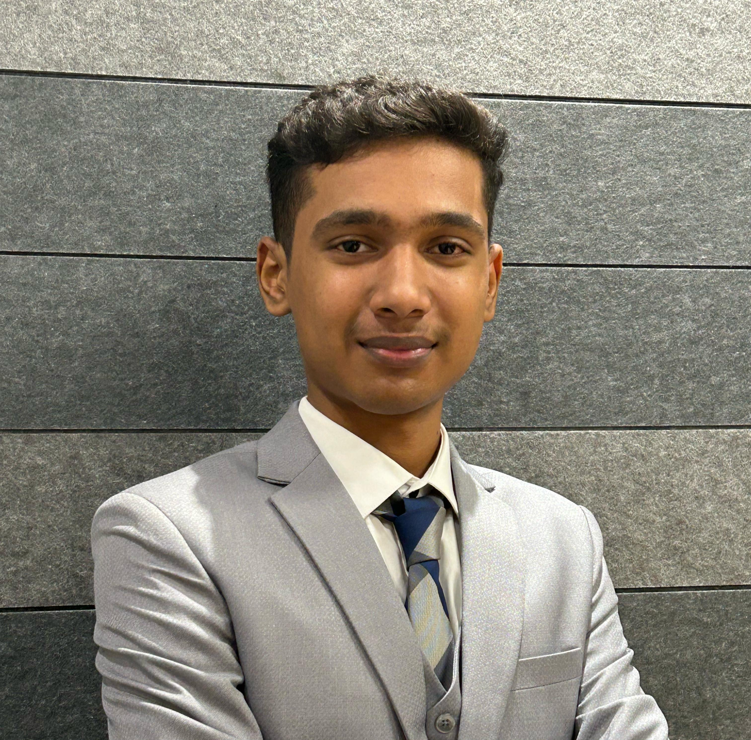


Appendix
Thara
Sangamitraa
Ideation
Yashovardhan
Karnawat
Ideation
Roghan
Ideation
PPT formatting
Content Refining ( Need gap to Marketing Mix )
Brand Name and Logo design.
Base Content ( STP , Ansoff and BCG matrix )
Content Refining.
Content Refining.
Base Content ( Need gap, Porters five forces, Aida, Product and Place)
Parinitha
Ideation
Base Content ( Promotion, helping with content ideas for others )
PPT Structuring.
Priyana
Ideation
Base Content ( Swot, Pestle, and promotion-ADS )
Video editing.

Slide 13
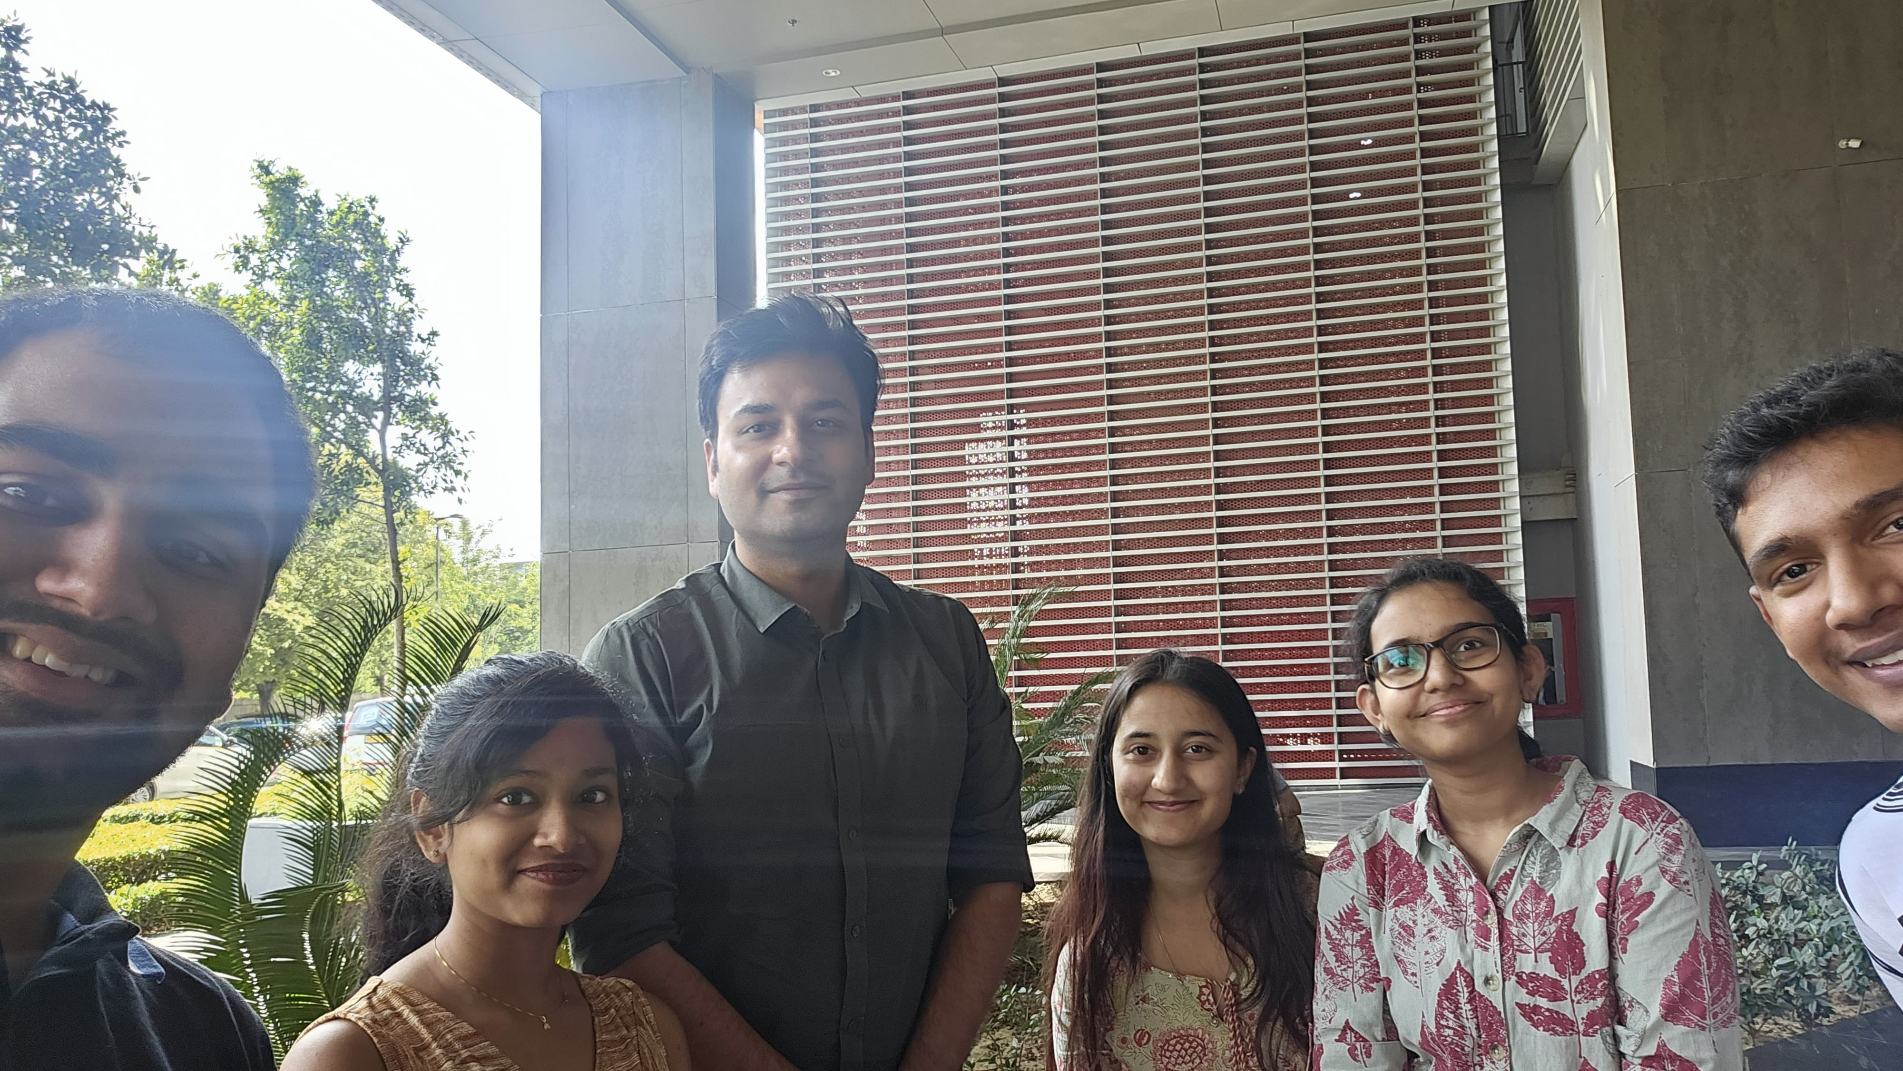
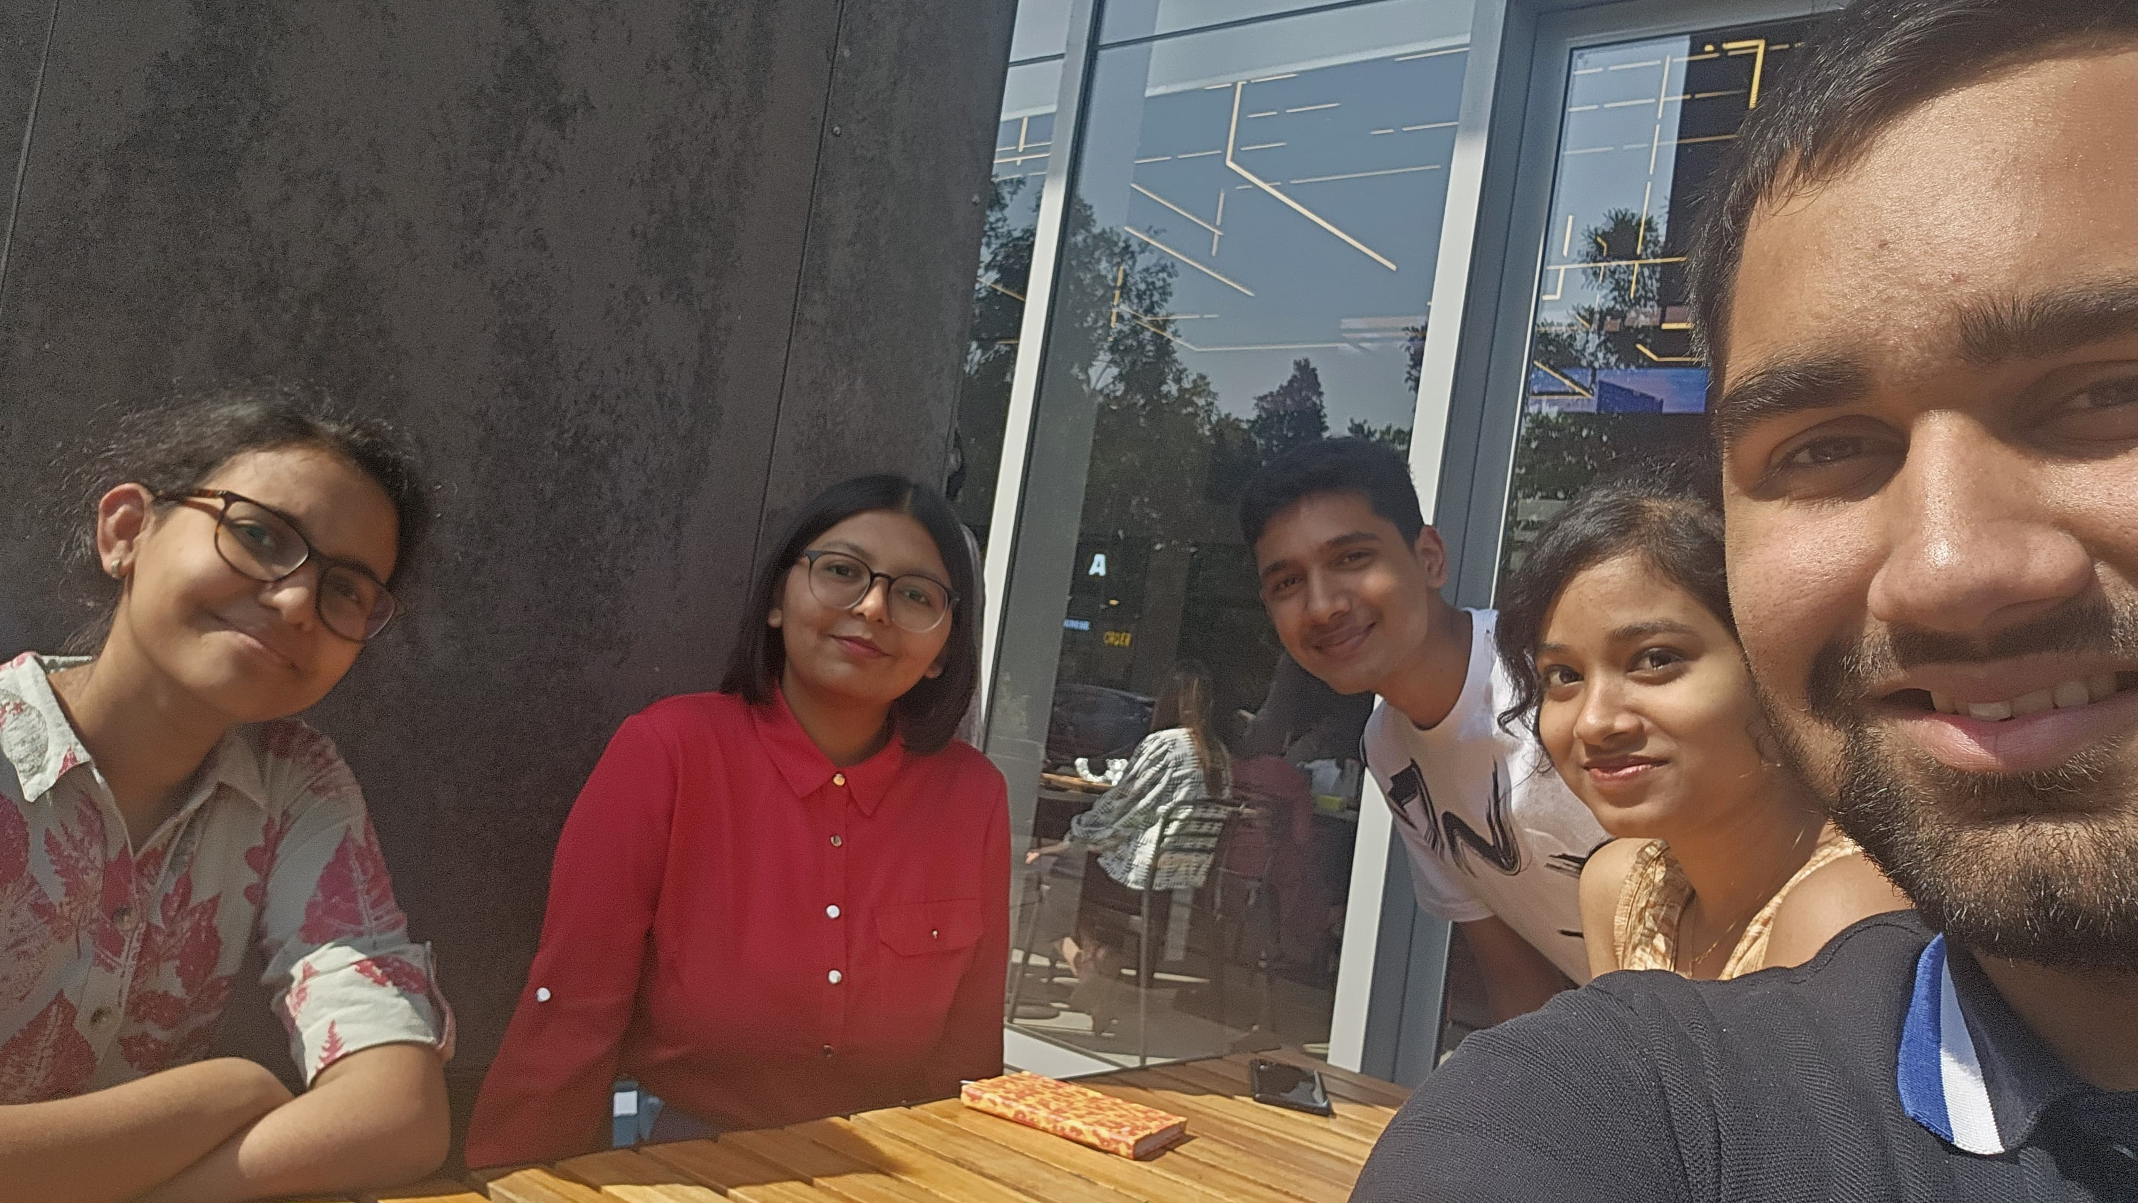
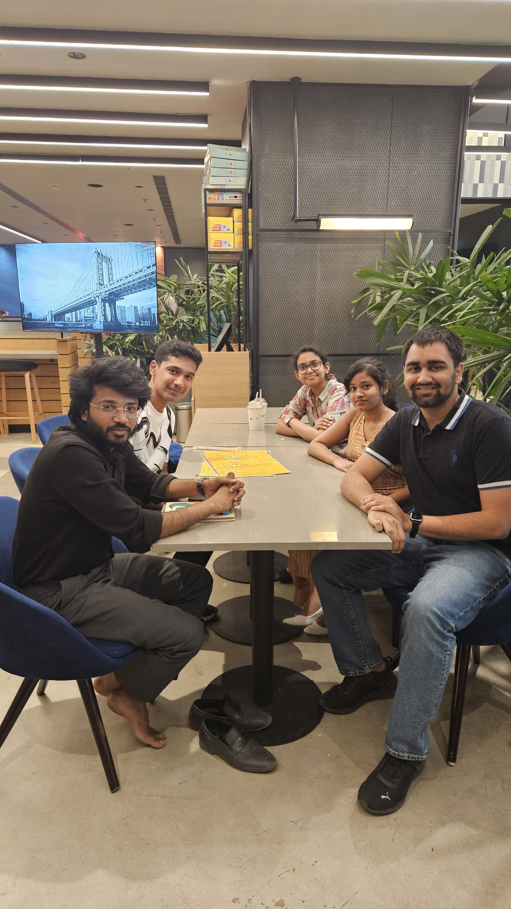
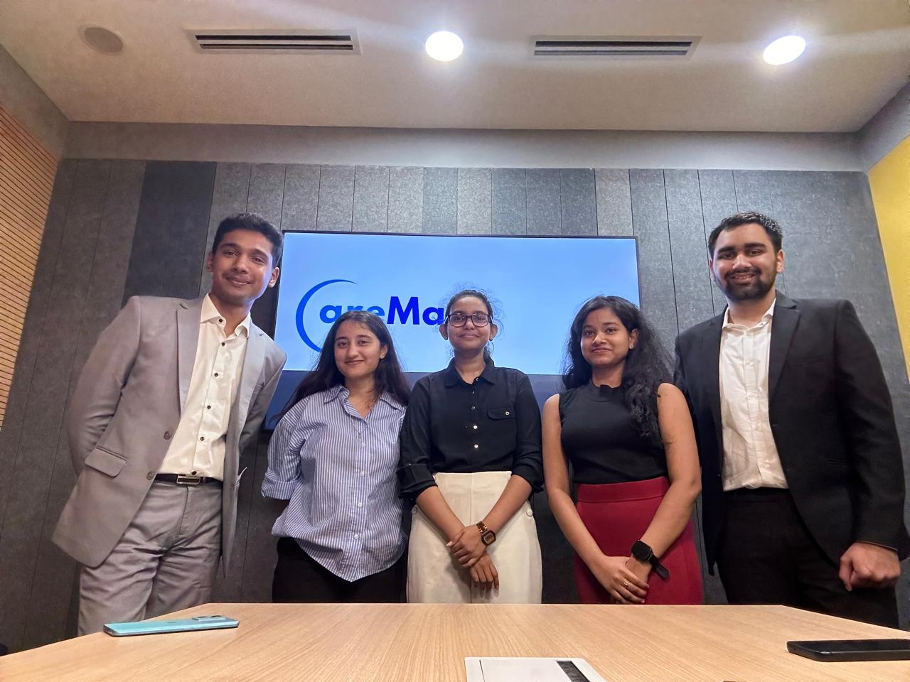
Thank You

